Slide 1

SCREENING OF POTENTIAL ANTIMICROBIAL PEPTIDES FOR CYSTIC FIBROSIS USING NETWORK AND DYNAMIC STUDIES
FINAL REVIEW PRESENTATION
Presented by
HARSHAYA S (922521214013)
SOUNTHARYA S (922521214046)
Department of Biotechnology
VSB Engineering College
Karur-639111
Under the guidance of
Dr. M. A. SUNDARAMAHALINGAM
Assistant Professor
Department of Biotechnology
VSB Engineering College
Karur-639111

Slide 2
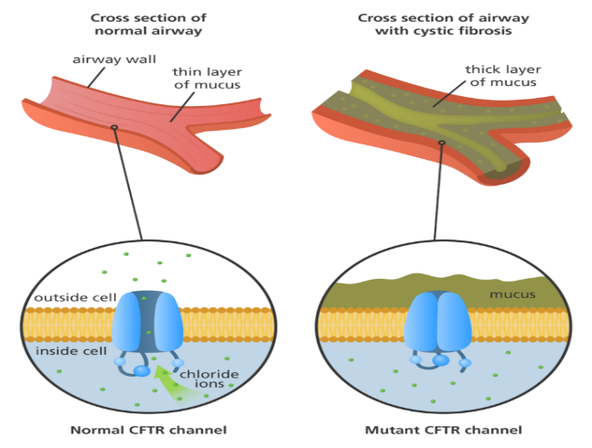
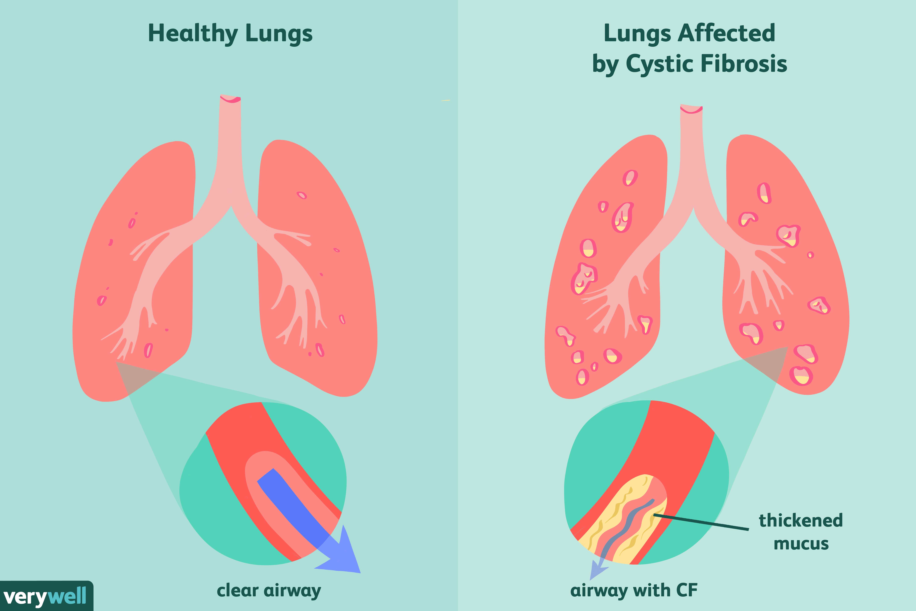
INTRODUCTION
CYSTIC FIBROSIS
Genetic Disorder caused by mutation in CFTR Gene ((ΔF508)phenylalanine (F) at the 508th amino acid position in the CFTR protein leads to a misfolded CFTR protein )
Chronic Respiratory Infection
Thick Mucus formation
Ideal Environment for microorganism such as Pseudomonas aeruginosa, Staphylococcus aureus which forms Biofilm
Recurrent Bacterial Infection

Slide 3
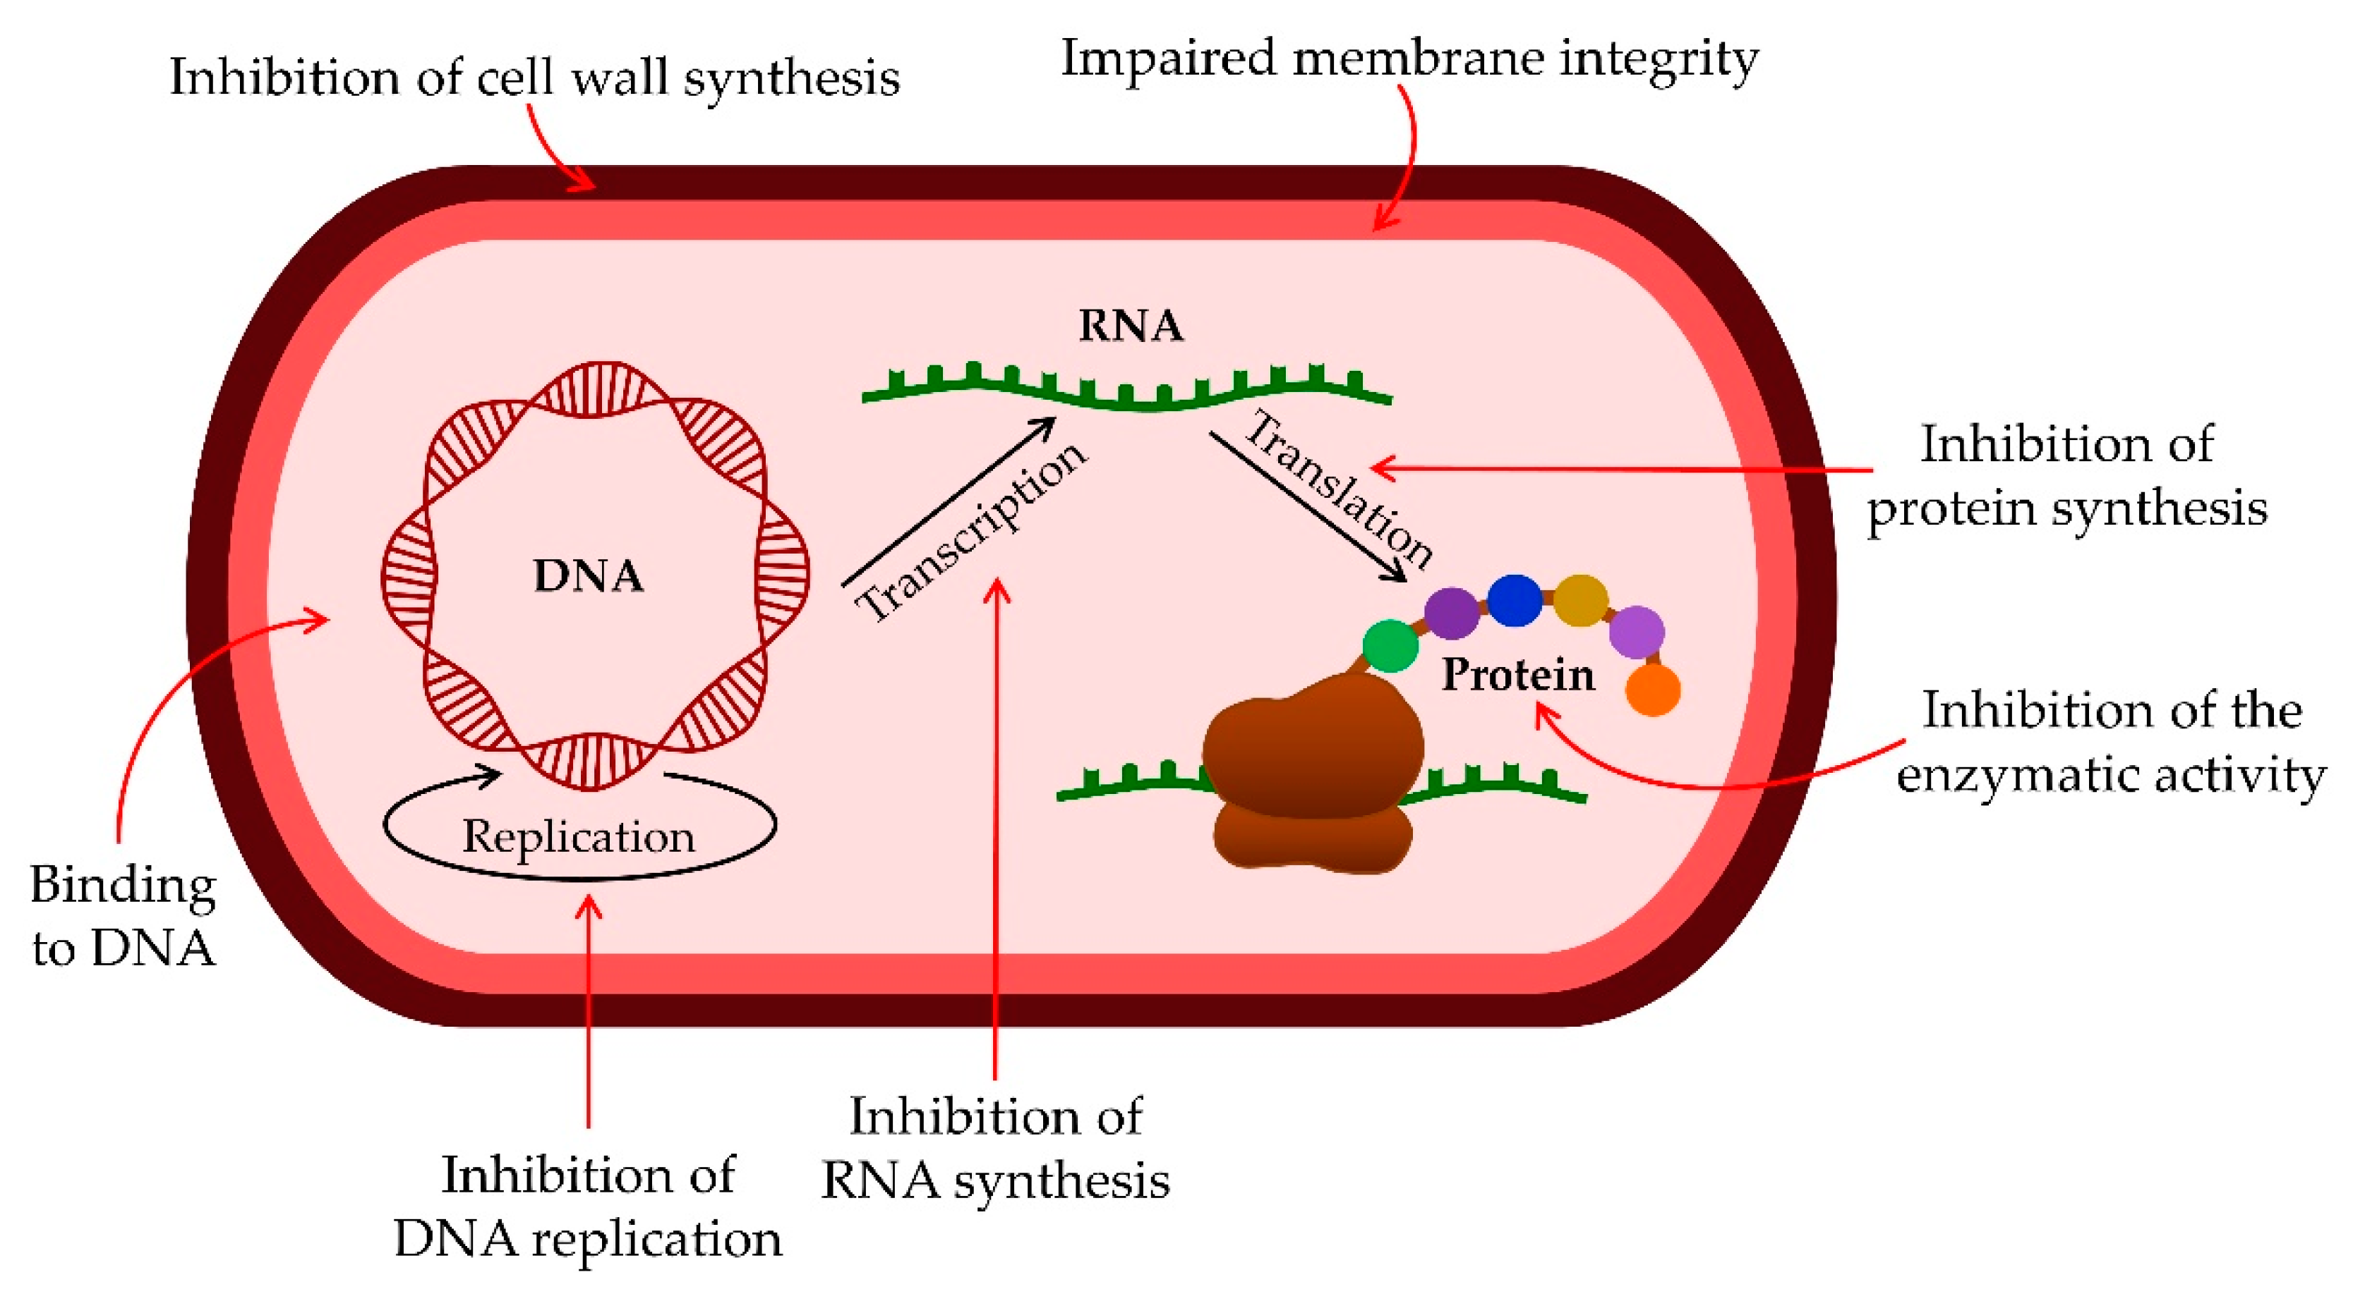
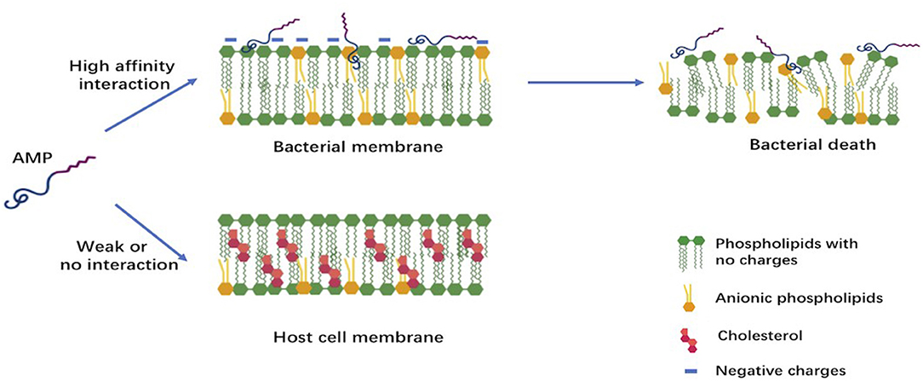
INTRODUCTION
ANTIMICROBIAL PEPTIDES (AMPs)
Crucial component in Innate Immune System
Short (5-50AA), Cationic, Amphipathic
Defense against the wide range of Pathogens
MECHANISM OF AMPs
AMPs bind selectively to bacterial membranes due to their cationic and amphipathic and disrupt bacterial membranes by forming pores or destabilizing the structure.
Membrane disruption leads to bacterial cell lysis.
AMPs can also penetrate and break down biofilms formed by CF pathogens.

Slide 4
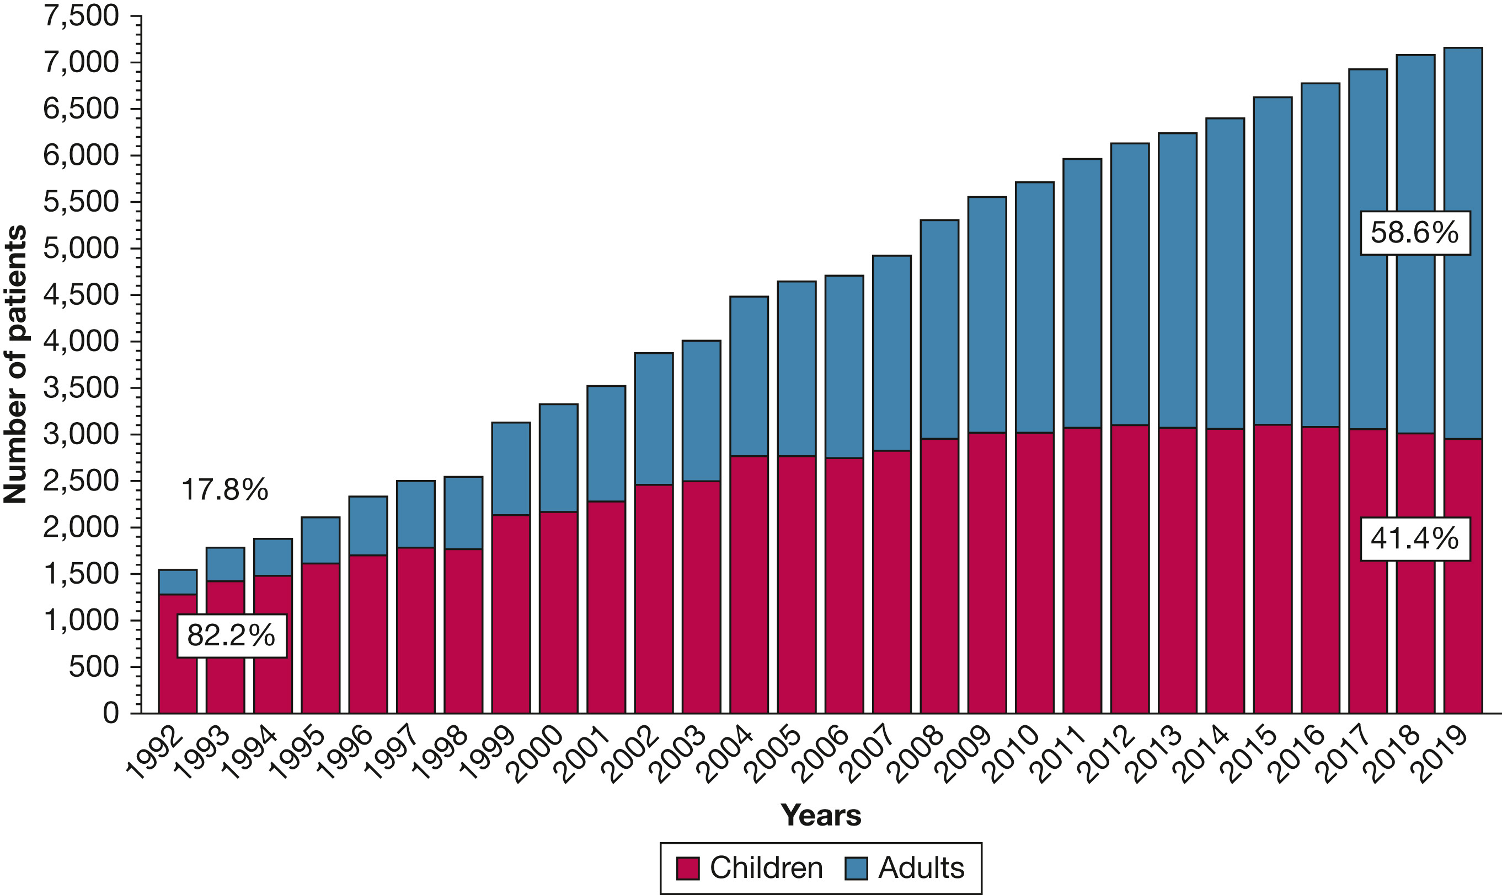


CURRENT PROBLEM
Above 18 aged people are affected by CF recently.
CF treatment remains challenging due to the vast diversity of peptides and the complexity of their interactions with pathogens.
Multi Drug Resistant (MDR) strains are a significant public health concern because they lead to longer hospital stays, higher medical costs, and increased mortality.

Slide 5

AIM AND OBJECTIVES
AIM :
To screen and identify potential antimicrobial peptides for cystic fibrosis by using network analysis and dynamic simulation studies to evaluate their interaction, stability, and therapeutic potential.
OBJECTIVES :
To analyze CF-associated regulatory genes using UniProt, STRING, and Cytoscape to build PPI networks.
To select AMPs from the APD3 database based on criteria like hemolytic activity, toxicity, and biofilm disruption.
To perform molecular docking to evaluate binding affinities and interactions of selected AMPs with CFTR.
To conduct 100 ns molecular dynamics simulations to examine the stability of AMP-CFTR complexes.

Slide 6

METHODOLOGY
Collection of Protein Data from available databases (Uniprot)
PPI Network Construction using STRING
Network visualization using Cytoscape and Hub gene identification
Screening of Antimicrobial Peptides (AMPs) for CF Treatment
Molecular Docking of AMPs with CF-Associated Pathogens
Molecular Dynamics (MD) Simulations for Stability & Efficacy

Slide 7
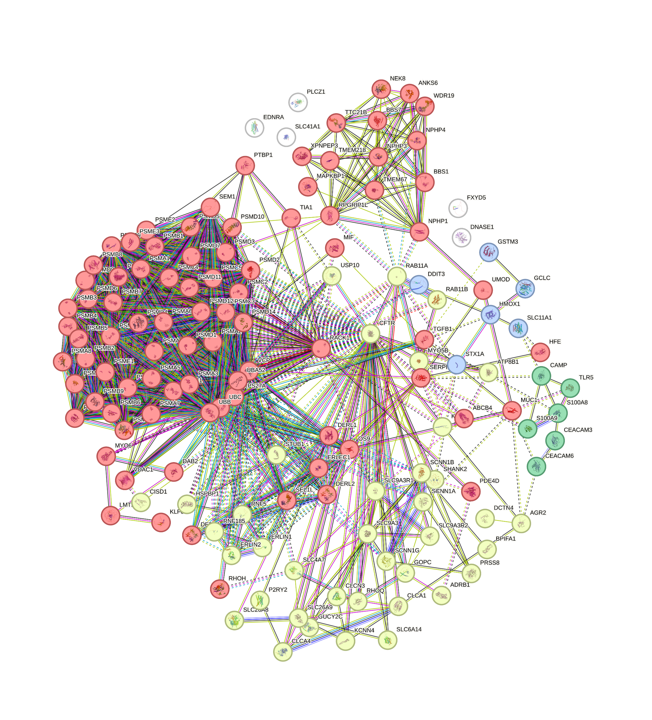
RESULTS AND DISCUSSION
It has 142 nodes and 1,669 edges.
Using a 0.4 confidence threshold, k-means clustering identified functionally related protein groups.
The network showed a high average node degree of 23.5 (protein's connectivity) and a local clustering coefficient of 0.69 (how tightly its neighbors are connected).
The network provides a molecular interaction map, guiding hub gene analysis in CF.
Protein-Protein Interaction (PPI) network construction using STRING v12.0

Slide 8
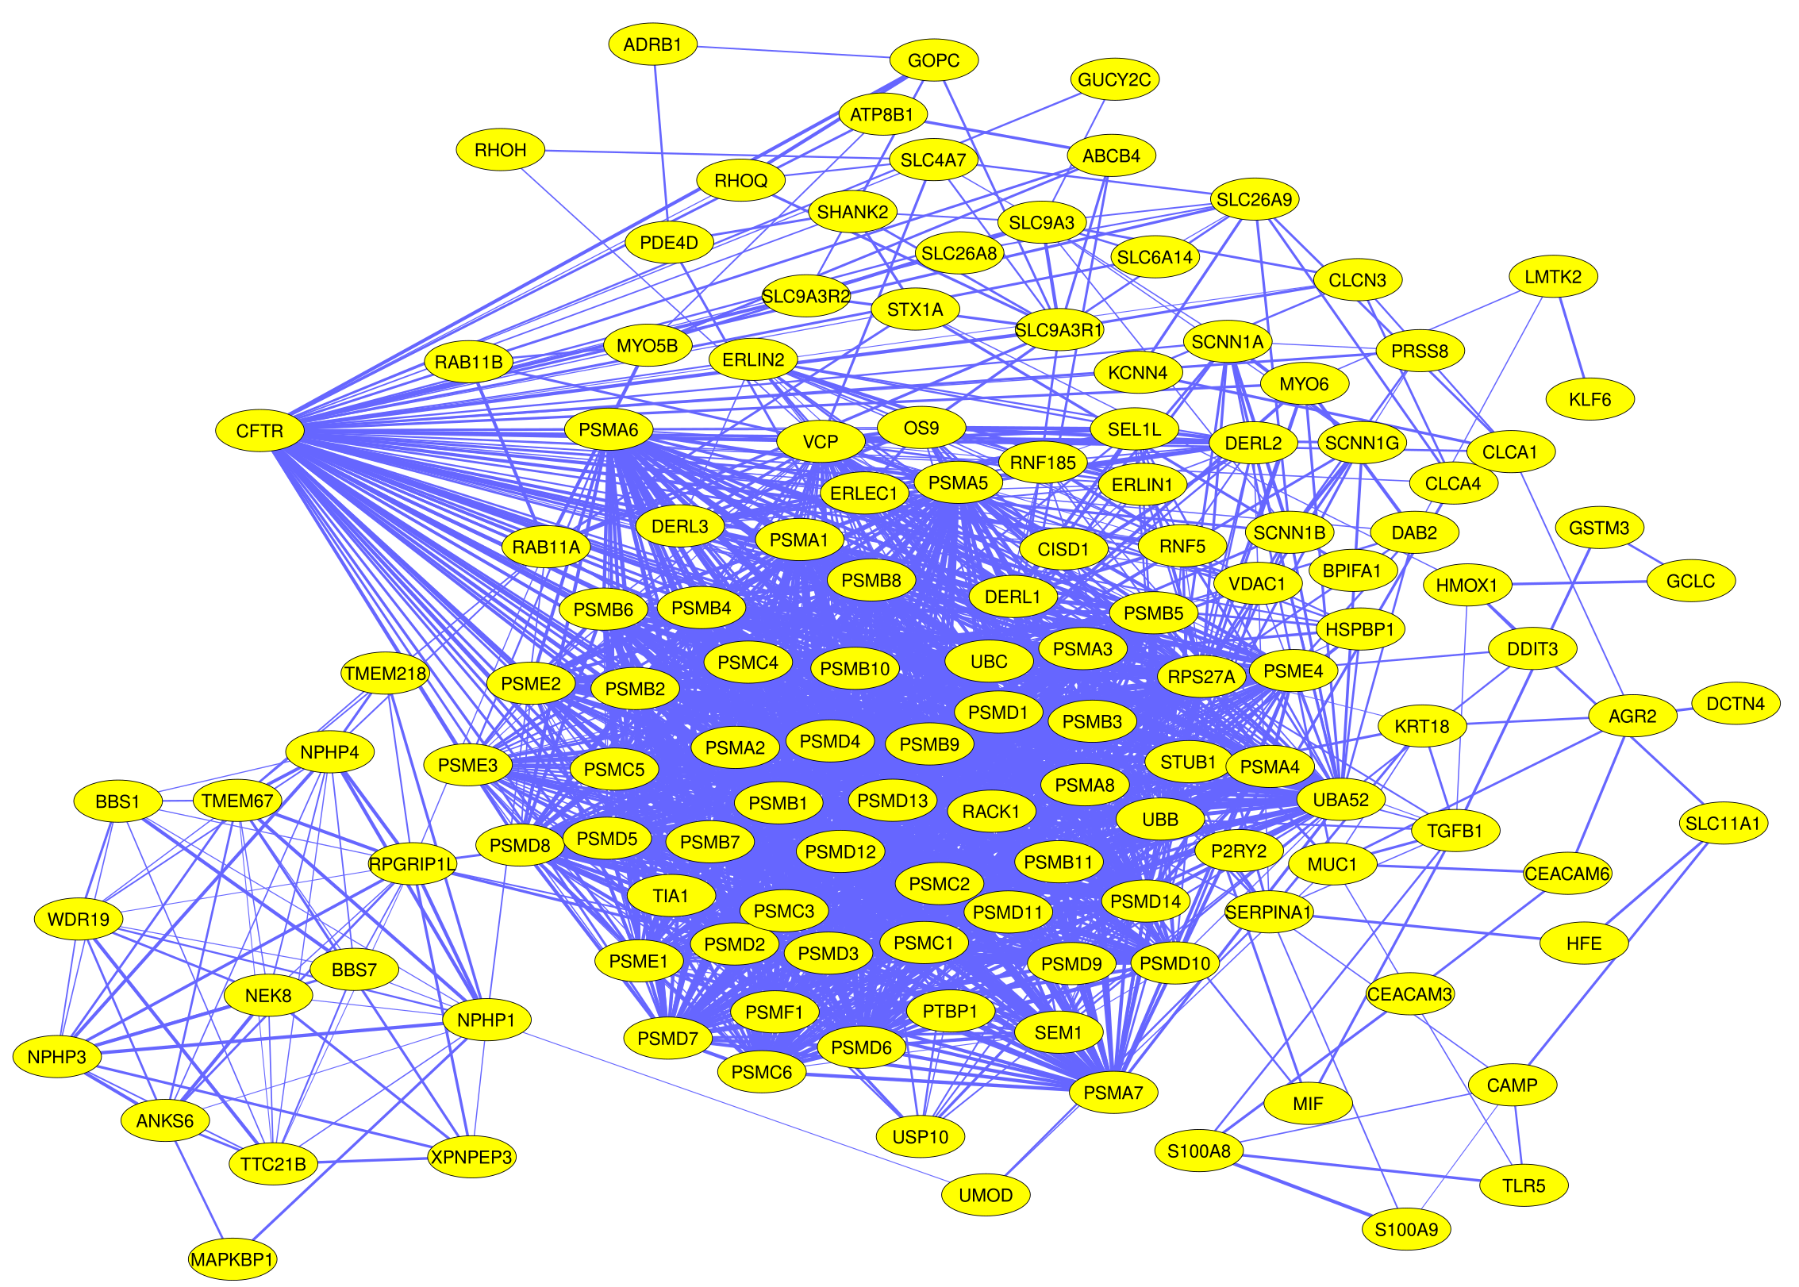
RESULTS AND DISCUSSION
The yFiles Organic layout (yFiles algorithm) was applied, which automatically arranges nodes based on natural interaction flow and cluster density.
Yellow nodes represent proteins, and blue edges denote interactions between them.
The network revealed dense clustering around central proteins
Network Visualization and analysis using Cytoscape version 3.10.0

Slide 9
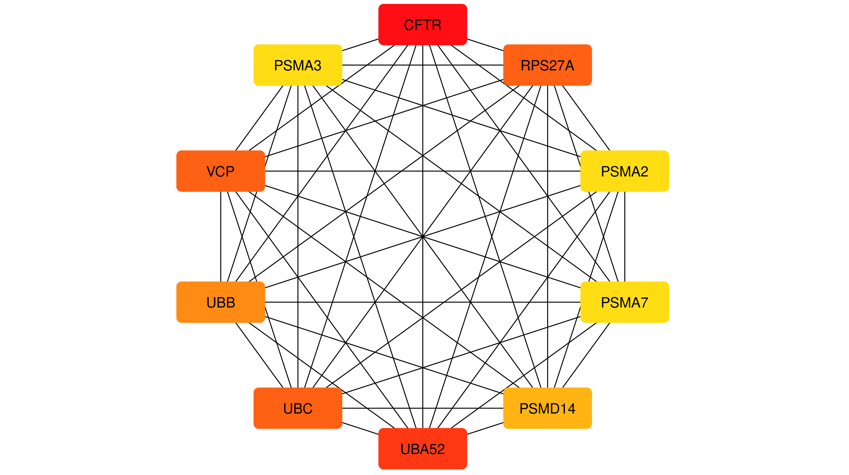
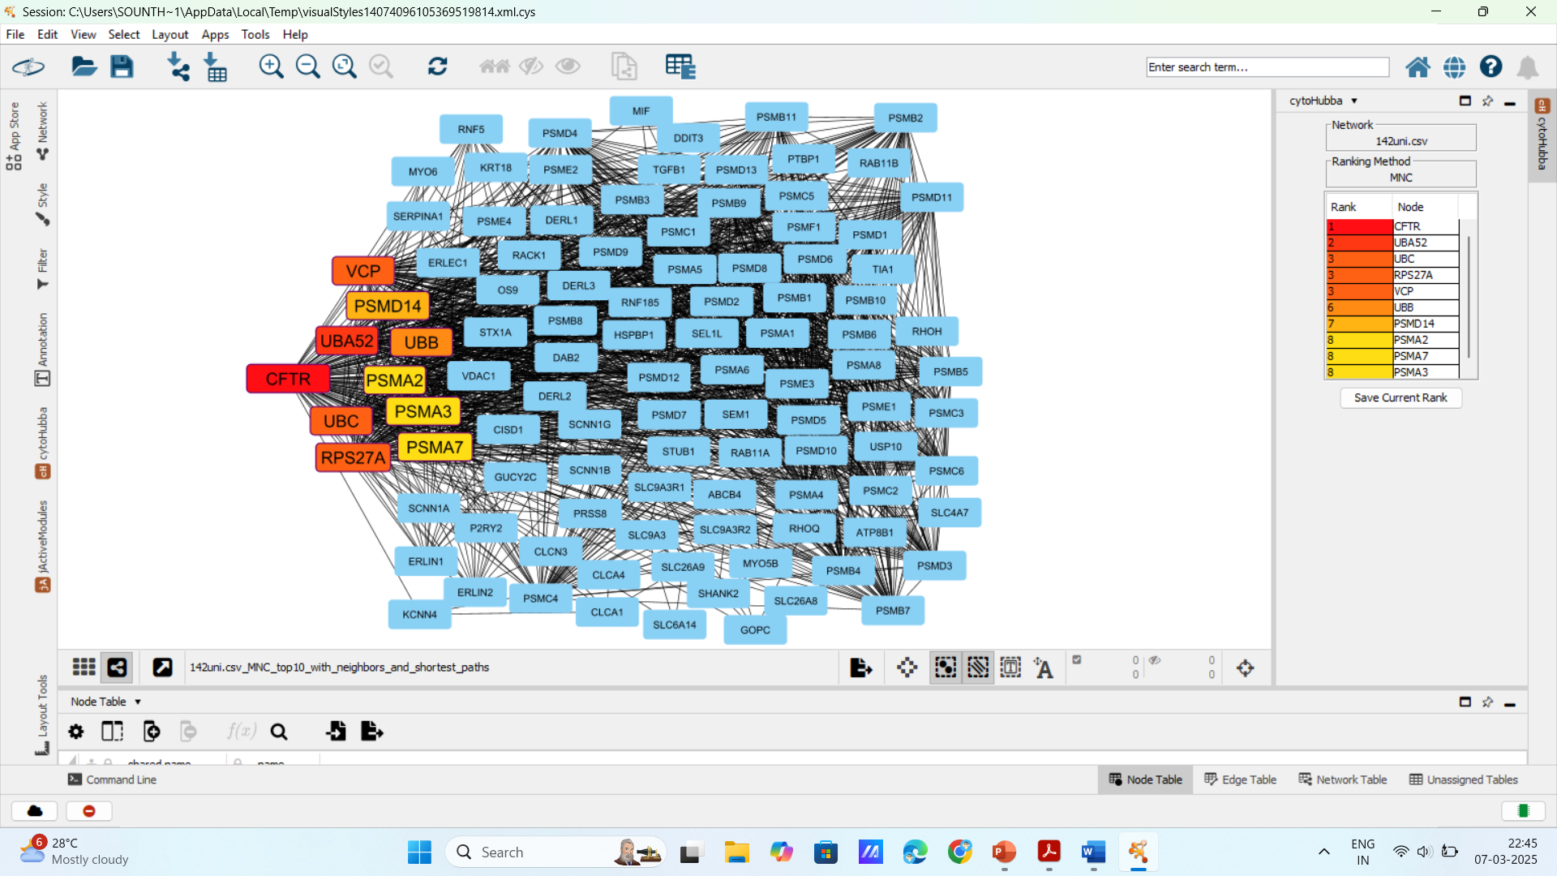
RESULTS AND DISCUSSION
The top 10 hub genes were identified, with CFTR ranked the highest based on maximum connectivity values.
CFTR exhibited the most significant connectivity, highlighting its critical regulatory role within the constructed network.
The identification of CFTR as a major hub supports its potential as a core therapeutic target in cystic fibrosis.
Centrality Analysis using Maximum Neighbourhood Component (MNC)

Slide 10

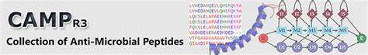
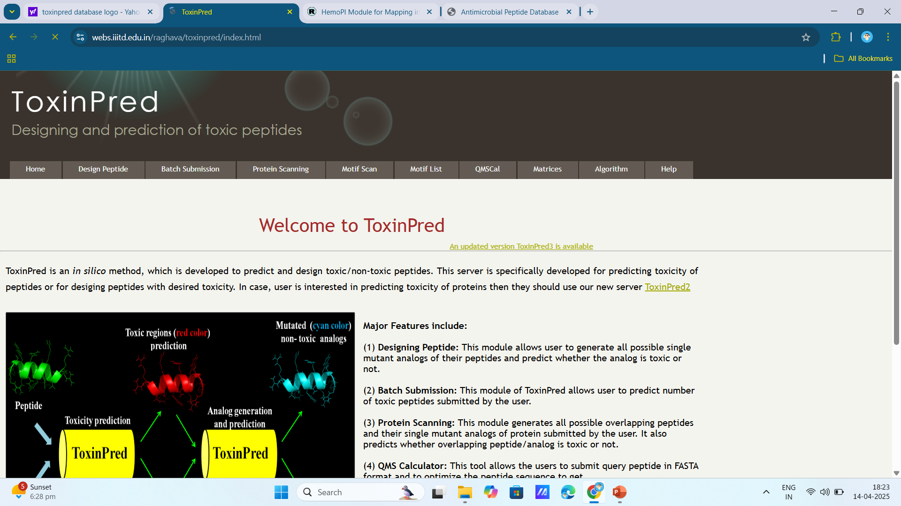


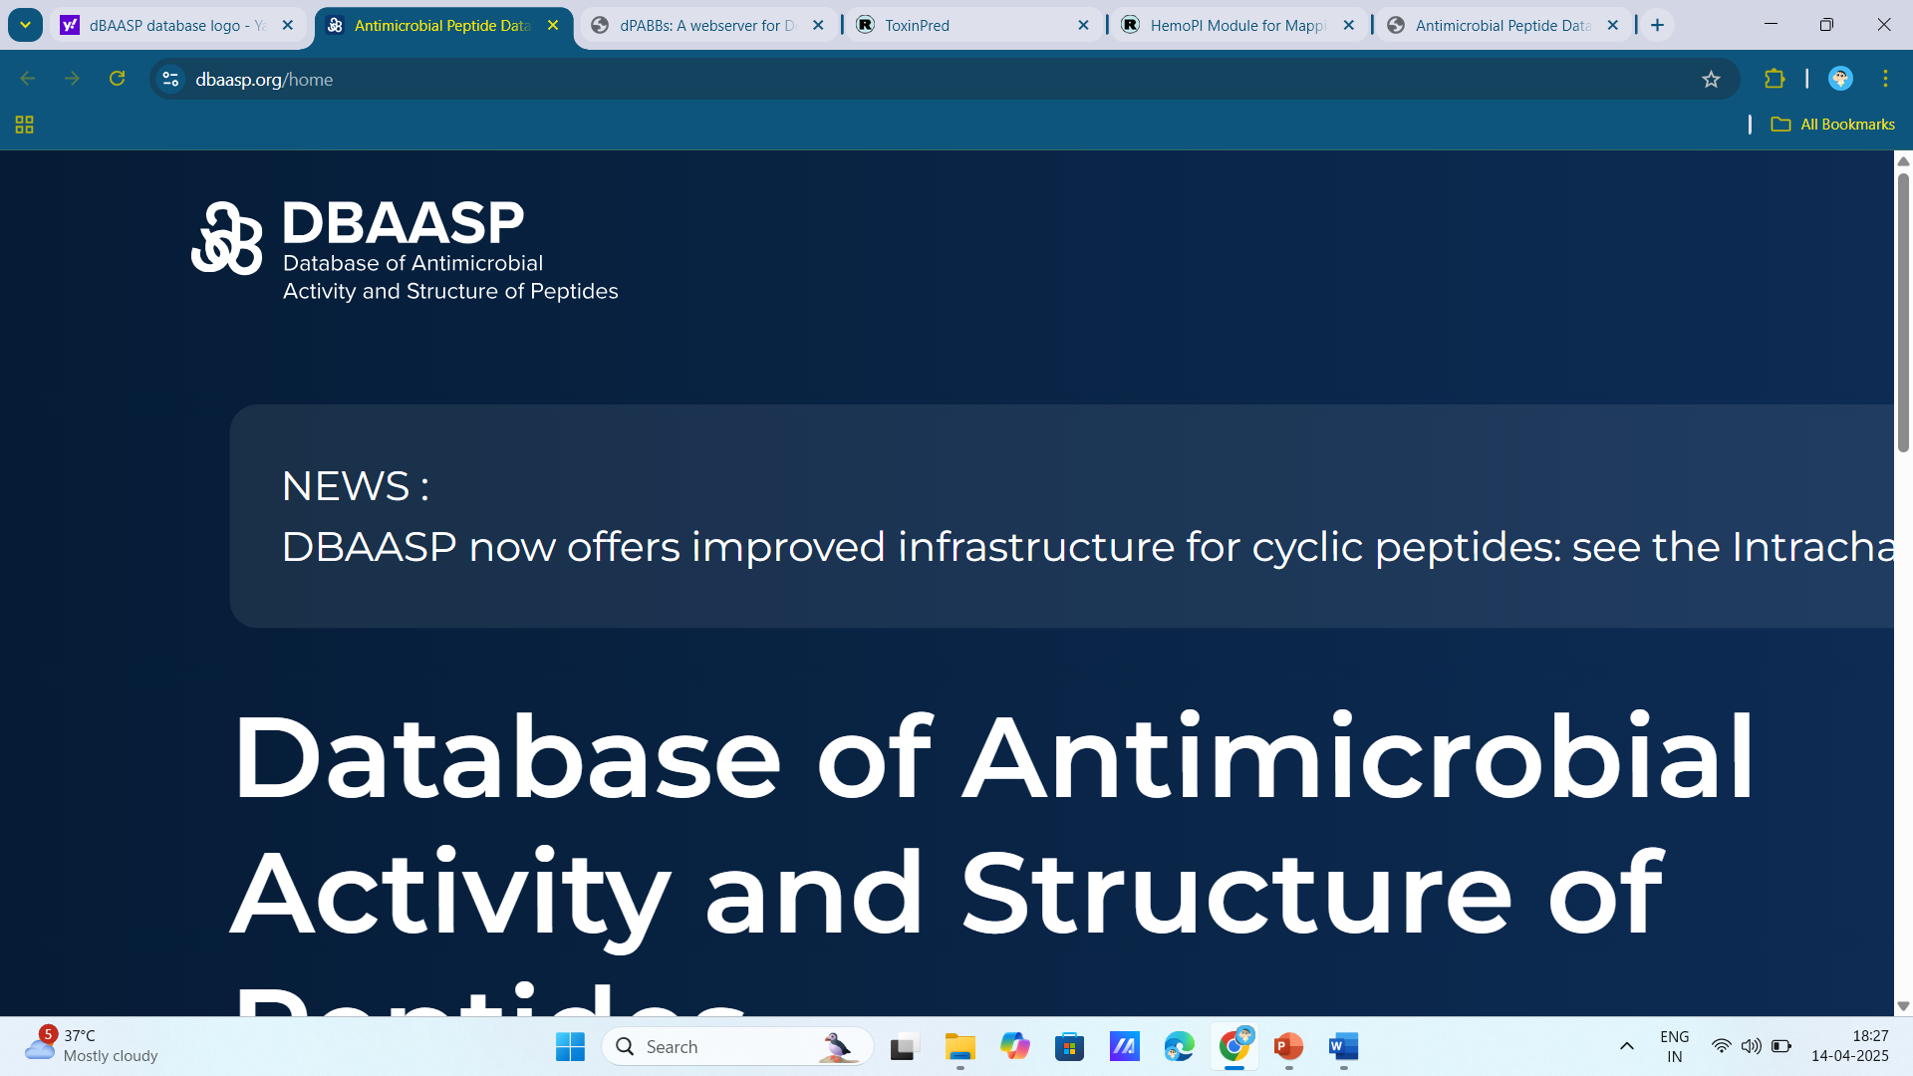
ANTI MICROBIAL PEPTIDES SCREENING
APD3 – Antimicrobial Peptide Database
3306 Natural AMPs
3306 Natural AMPs Sequence and Length (5-30AA – 1776 AMPs)
650 Non-Toxin AMPs
665 Non-Hemolytic AMPs
PeptideRanker
369 Biofilm- active AMPs
39 AMPs against P. aeruginosa & S. aureus
10 AMPs with ranking scores of about >0.8

Slide 11
RESULTS AND DISCUSSION
ANTIMICROBIAL PEPTIDE SCREENING
Peptide ID | Peptide Sequence (APD3) | Peptide Length | Accession Number | Prediction (HemoPred) | Toxicity (ToxinPred) | Prediction (dPABBs) | Pseudomonas (dBAASP) | Staphylococcus (dBAASP) | Peptide Ranker
Peptide_1 | KIKFLKVLT | 9 | AP02201 | Non-Hemolytic | Non-Toxin | Biofilm-active | Active | Active | 0.997067
Peptide_2 | INWKGIAAMAKKLL | 14 | AP02355 | Non-Hemolytic | Non-Toxin | Biofilm-active | Active | Active | 0.994509
Peptide_3 | NLKAIAALAKKLL | 13 | AP02362 | Non-Hemolytic | Non-Toxin | Biofilm-active | Active | Active | 0.991304
Peptide_4 | INLKAITALAKKLL | 14 | AP02363 | Non-Hemolytic | Non-Toxin | Biofilm-active | Active | Active | 0.990002
Peptide_5 | INLKAIAPLAKKLL | 14 | AP02364 | Non-Hemolytic | Non-Toxin | Biofilm-active | Active | Active | 0.977801
Peptide_6 | RLFRHAFKAVLRL | 13 | AP02430 | Non-Hemolytic | Non-Toxin | Biofilm-active | Active | Active | 0.975108
Peptide_7 | AGLQFPVGRIGRLLRK | 16 | AP02447 | Non-Hemolytic | Non-Toxin | Biofilm-active | Active | Active | 0.947293
Peptide_8 | LRLKSIVSYAKKVL | 14 | AP02542 | Non-Hemolytic | Non-Toxin | Biofilm-active | Active | Active | 0.940122
Peptide_9 | GLLSALRKMIPHILSHIKK | 19 | AP02740 | Non-Hemolytic | Non-Toxin | Biofilm-active | Active | Active | 0.879878
Peptide_10 | INLKAIAALAKKLF | 14 | AP02890 | Non-Hemolytic | Non-Toxin | Biofilm-active | Active | Active | 0.814254

Slide 12
PROTEIN, AMPs STRUCTURE RETRIEVAL
CFTR Protein
PDB ID : 1XMI
PE1
Mastoparan-X
Mastoparan-VT2
Mastoparan-VT3
Mastoparan-VT4
Pep39
Scolopendin 2
Mastoparan-S
Scolopendin 2
Mastoparan-AF

Slide 13
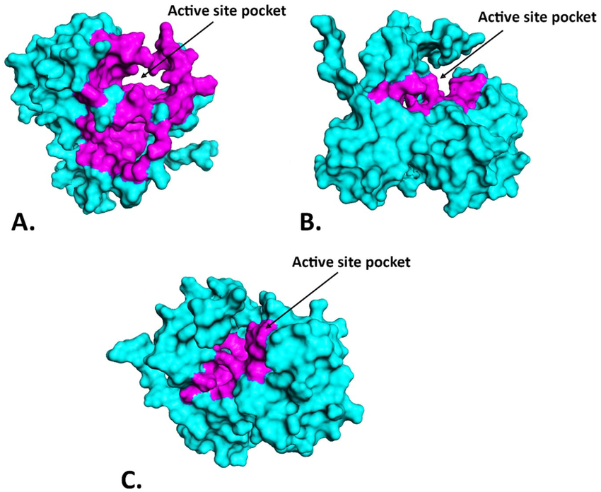
ACTIVE SITE PREDICTION & MOLECULAR DOCKING
The SCFBio Active Site Prediction Tool was used to identify the target protein's active site by evaluating its 3D structure's geometric and physicochemical features.
The active site was located at coordinates X = 17.077, Y = 56.583, and
Z = 119.771, guiding the docking process.
A grid box of 35Å was placed around the active site coordinates to restrict docking simulations to the binding region.
Molecular docking was performed with AutoDock Vina, using in-house Python and shell scripts on an HPC (High Performance Computing) system.
The docking results were analyzed to determine the best binding poses and calculate binding affinities, identifying the most promising interactions.

Slide 14
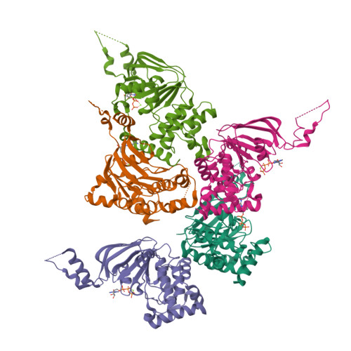
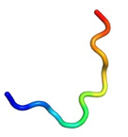
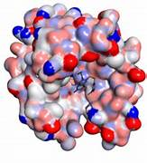
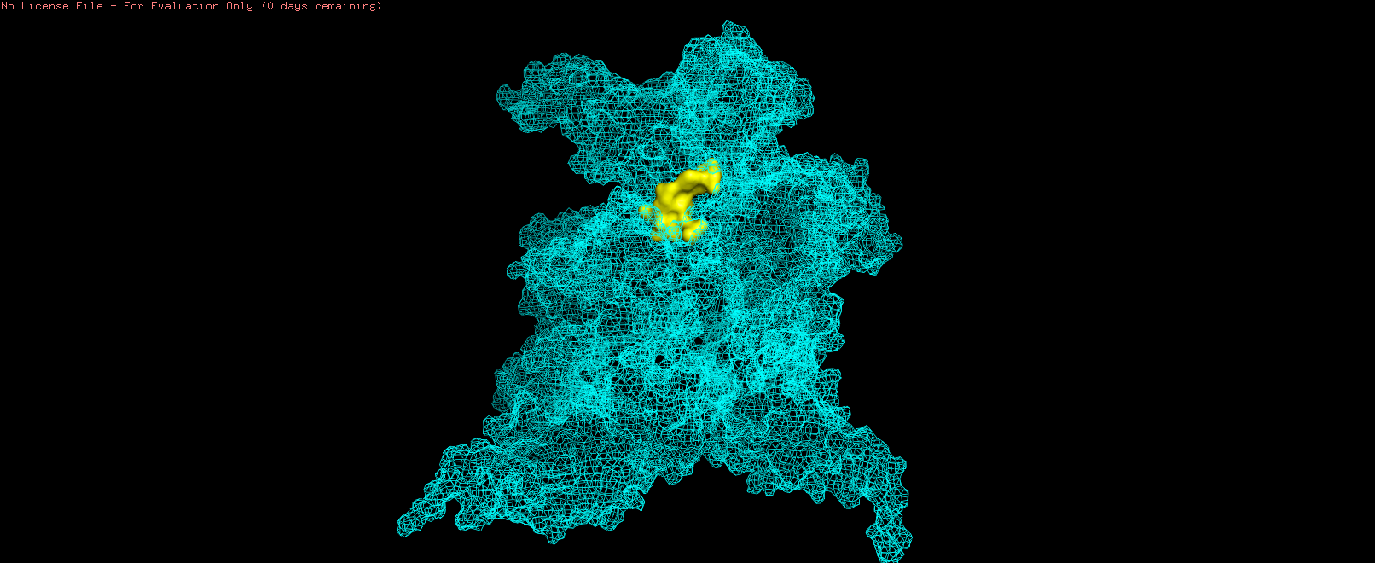
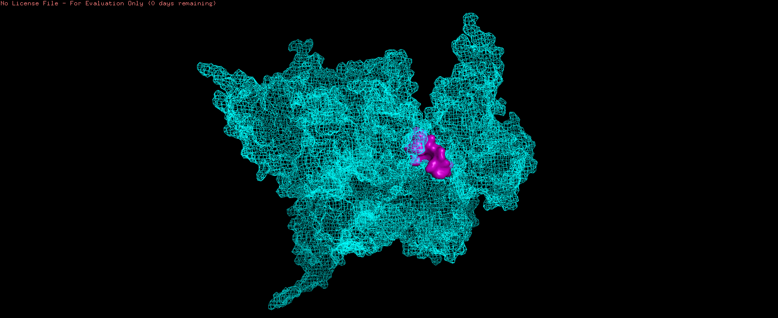
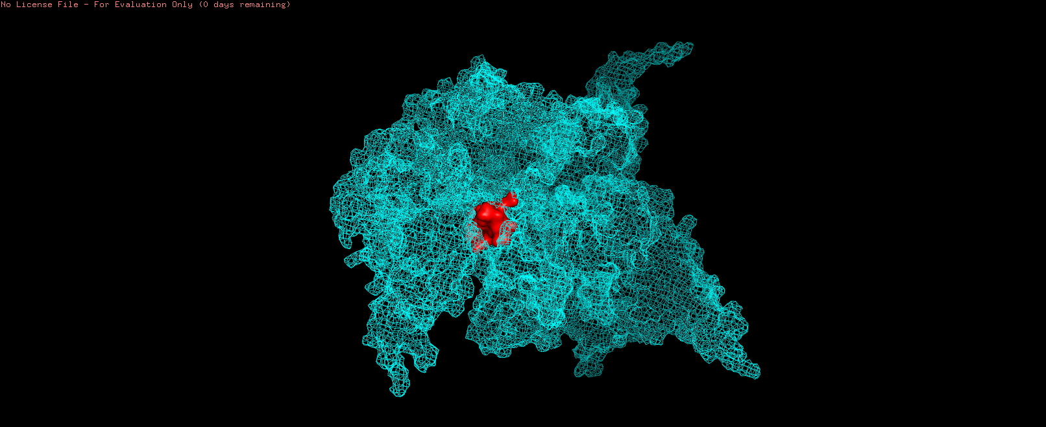
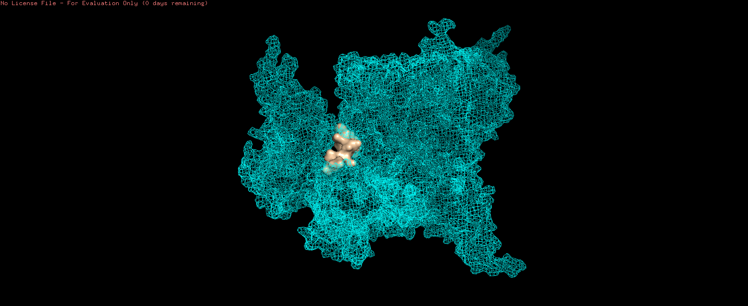
RESULTS AND DISCUSSION
CFTR
Predicted 10 AMPs
MOLECULAR DOCKING
PEP_1
Affinity Score = -6.9
PEP_2
Affinity Score = -7.4
PEP_3
Affinity Score = -6.7
PEP_4
Affinity Score = -6.8

Slide 15
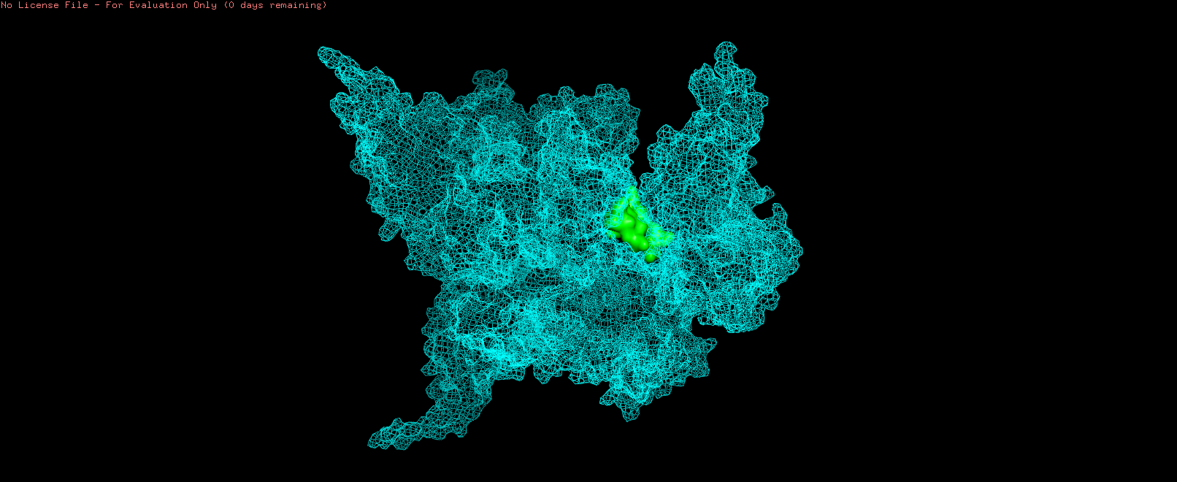
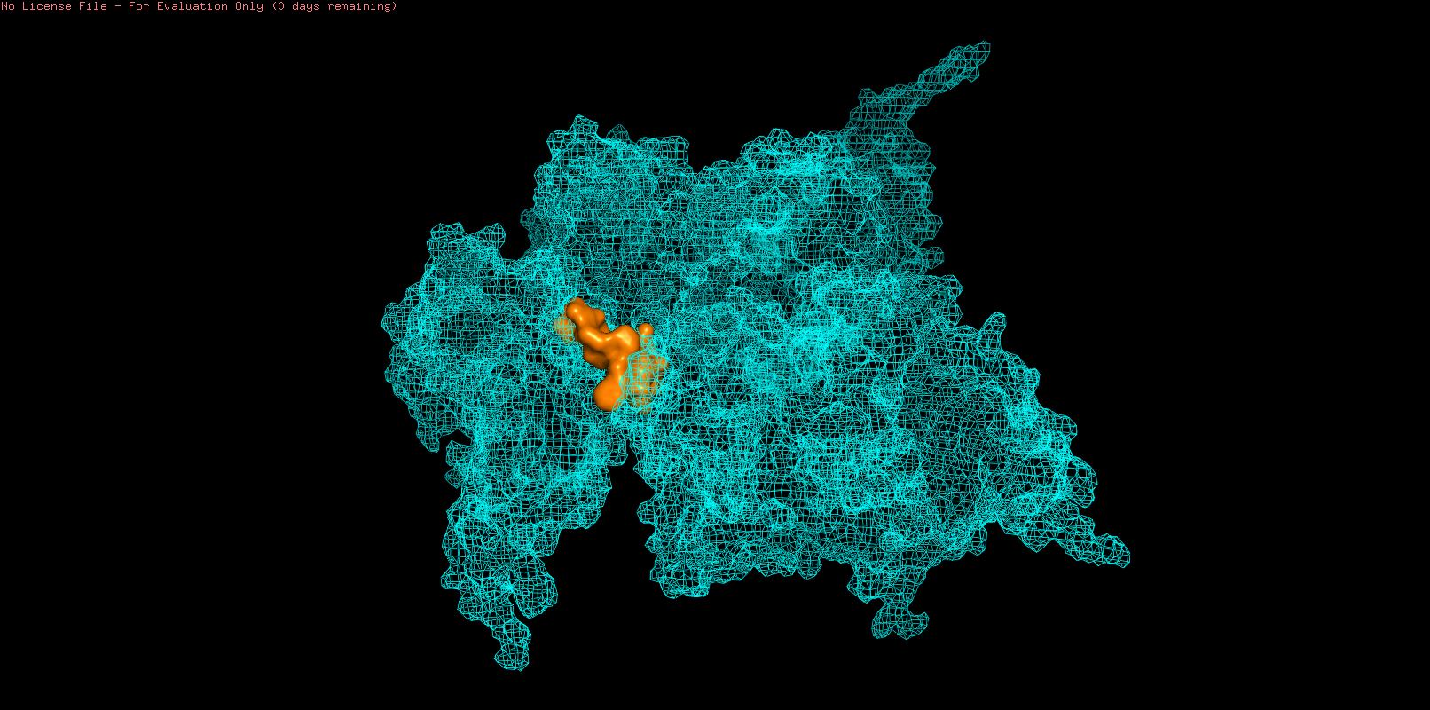
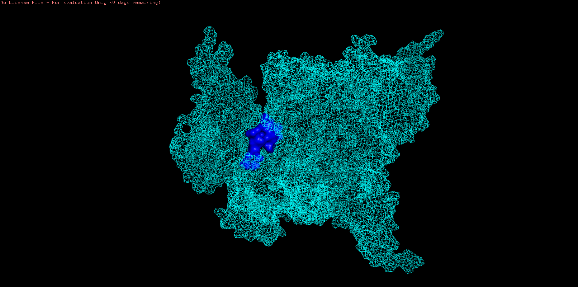
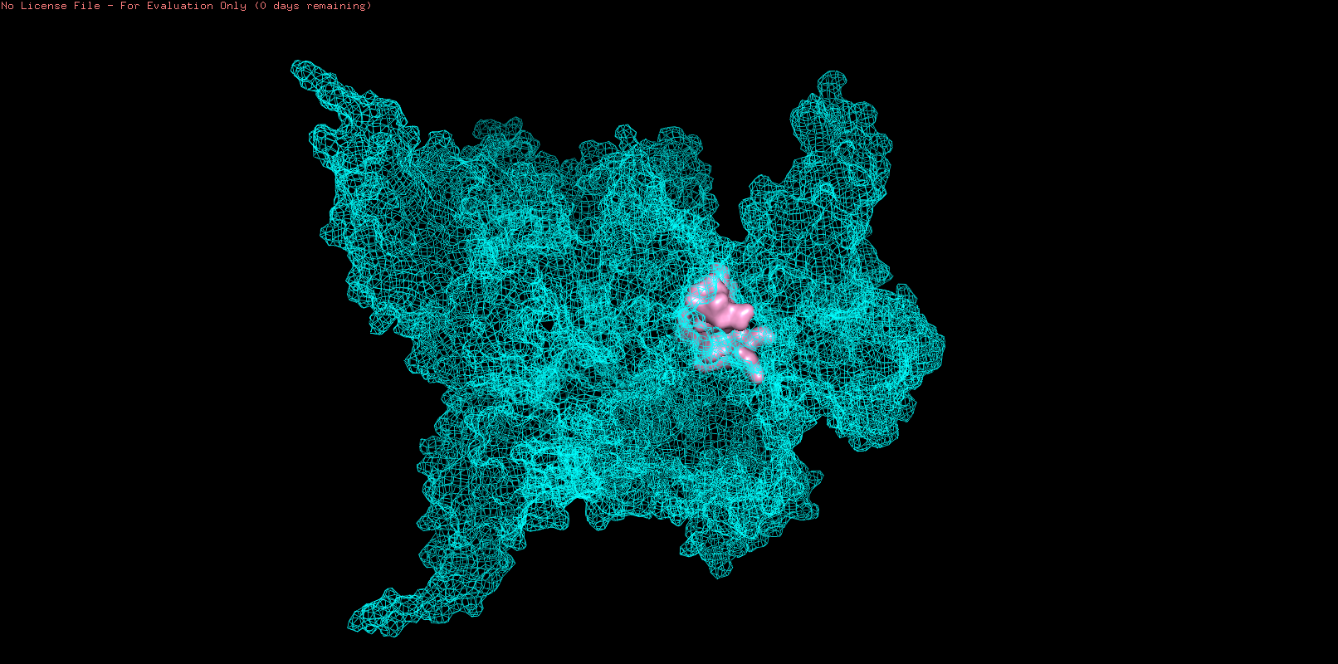
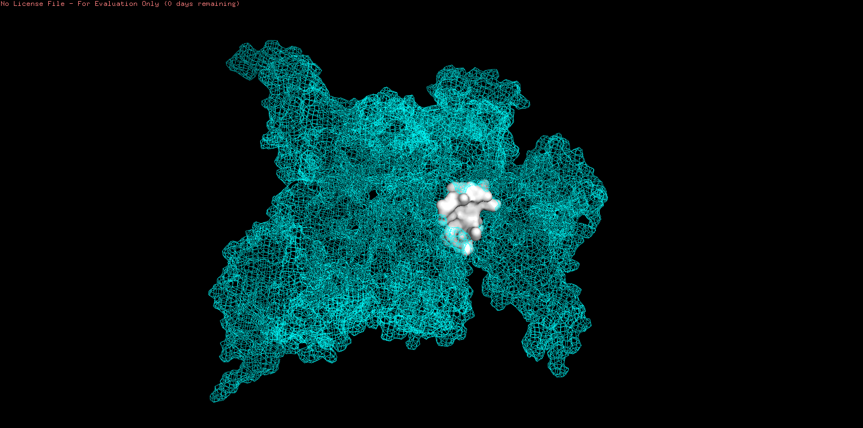
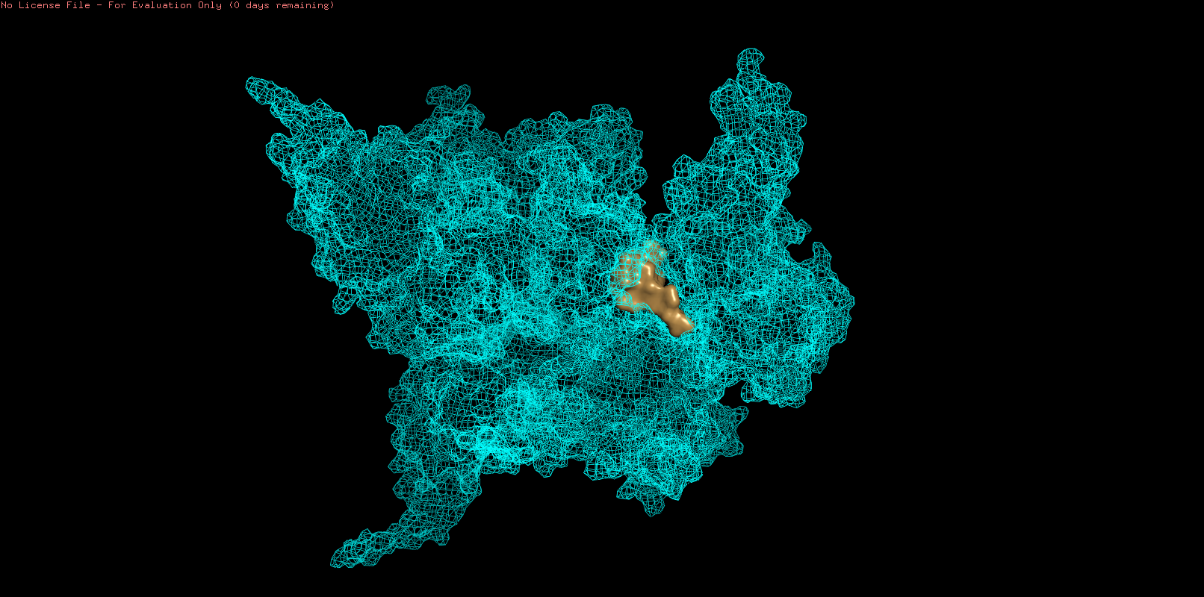
PEP_5
Affinity Score = -6.8
PEP_6
Affinity Score = -6.4
PEP_7
Affinity Score = -7.6
PEP_8
Affinity Score = -7.3
PEP_9
Affinity Score = -7.3
PEP_10
Affinity Score = -7.3

Slide 16
MOLECULAR DYNAMIC (MD) SIMULATION
MOLECULAR DYNAMIC SIMULATION WITH CFTR AND AMP_7
What is MD Simulation?
It is a computational technique used to study the physical movements of atoms and molecules over time. It is widely applied in chemistry, biophysics, materials science, and drug discovery to understand molecular interactions, protein folding, material properties, and more..
Why Simulate Protein + AMPs?
To see how the two antimicrobial peptides (AMPs) bind to protein.
Predict which AMP sticks better (stronger binding = more effective drug).
How It Helps our Project?
Captures the real-time motion of every atom in a system (protein flexibility, AMP binding and interactions)
Finds the "best" AMP: Checks which one stabilizes the protein or disrupts bacteria more effectively.

Slide 17
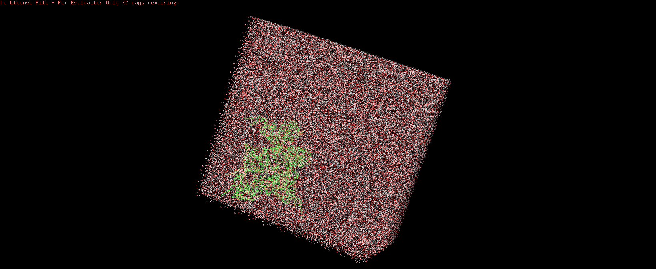
MOLECULAR DYNAMIC (MD) SIMULATION
System Preparation
Solvation
Ions Addition
Energy Minimization
Equilibration
Production MD
Analysis

Slide 18
MOLECULAR DYNAMIC (MD) SIMULATION
SYSTEM PREPARATION
SOLVATION
GROMACS 2021.5 and AMBER95ILDN force field were used to prepare the CFTR protein and Scolopendin 2 peptide, ensuring accurate torsion and electrostatic interactions.
The ACPYPE tool was used to generate consistent topology files, ensuring compatibility and accurate parameterization for the simulation setup.
The peptide–protein complex was placed in a triclinic box with a buffer distance, preventing boundary effects during simulation.
Solvation utilized TIP3P water molecules, known for their reliability in maintaining hydrogen-bonding networks in aqueous environments.

Slide 19
MOLECULAR DYNAMIC (MD) SIMULATION
IONs ADDITION
ENERGY MINIMIZATION
7 Sodium (Na⁺) and 1 chloride (Cl⁻) ions were added to neutralize the system and simulate physiological ionic strength (0.15 M).
The ion addition ensured charge balance, improving electrostatic stability and reducing artifacts in the simulation.
Applied the steepest descent algorithm to eliminate steric clashes and geometric strain, ensuring the system started in a stable and energetically favorable configuration.
Ensured the system reached a low-energy conformation, by minimizing potential instability from high-energy contacts.

Slide 20
MOLECULAR DYNAMIC (MD) SIMULATION
EQUILIBRATION
PRODUCTION MD
Performed equilibration in two phases: NVT (constant volume and temperature) to stabilize the temperature, followed by NPT (constant pressure and temperature) to equilibrate pressure and density, maintaining biologically relevant conditions.
Ensured system stability at 310 K and 1 bar pressure, preparing the system for a stable and realistic production run.
Executed a 100 ns production run with a 2-femtosecond timestep, capturing detailed dynamics of CFTR and Scolopendin 2 interactions.
Applied the PME (Particle Mesh Ewald) method for long-range electrostatics and the LINCS algorithm for bond constraints, ensuring both computational efficiency and accurate modeling of interactions.

Slide 21
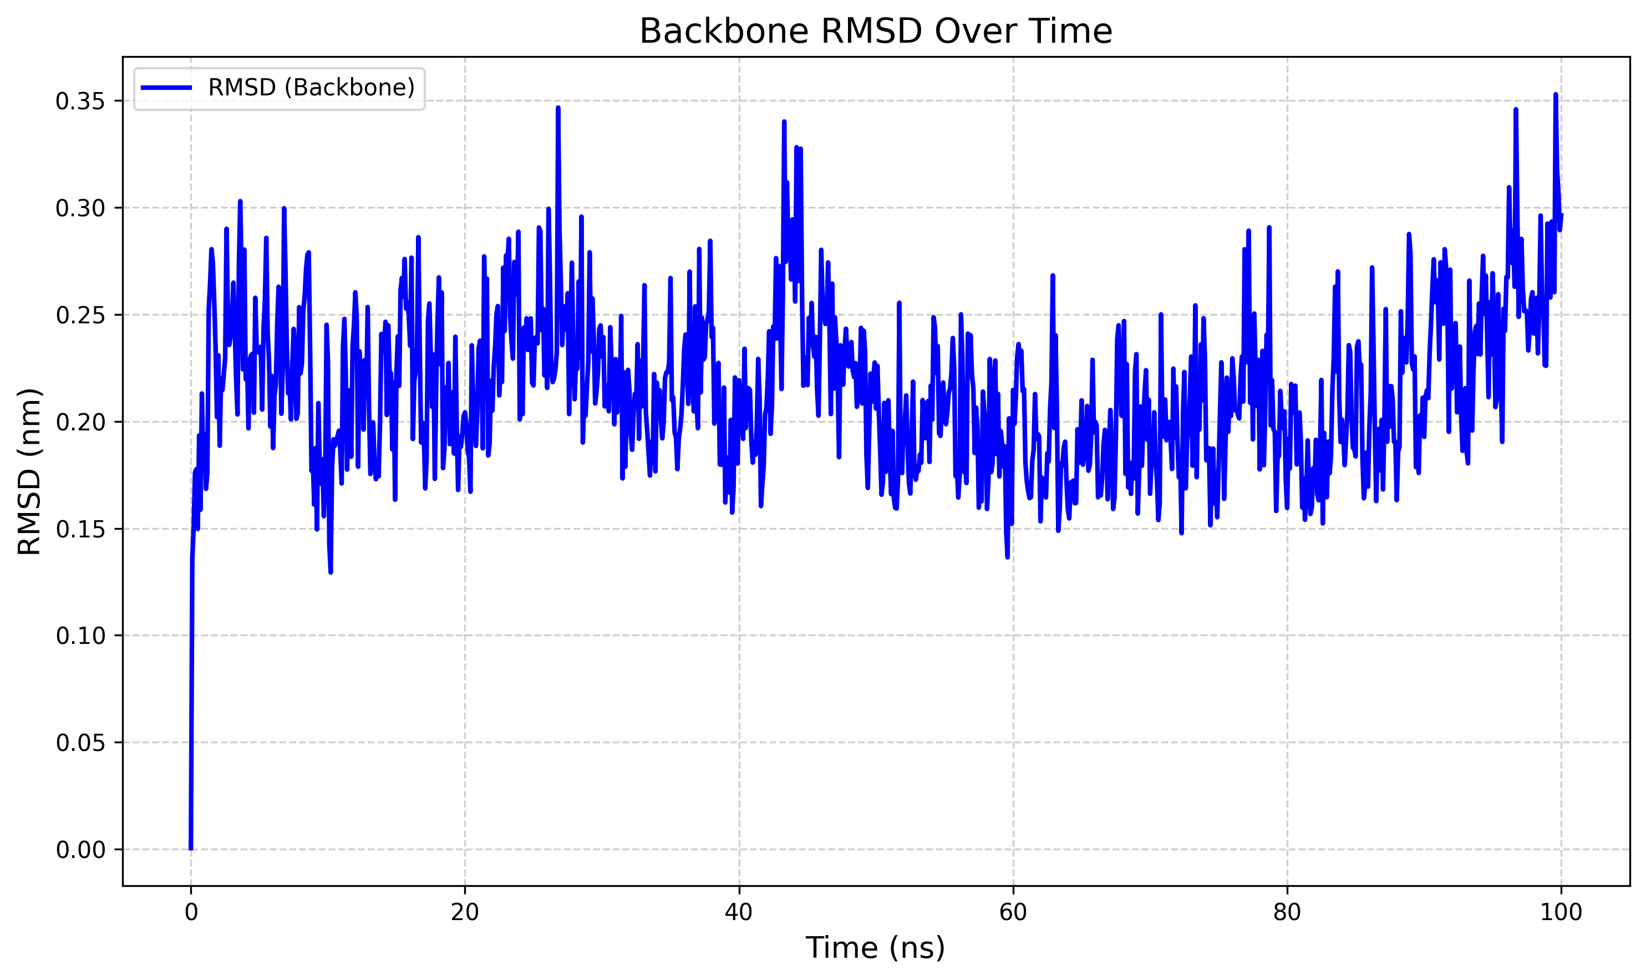
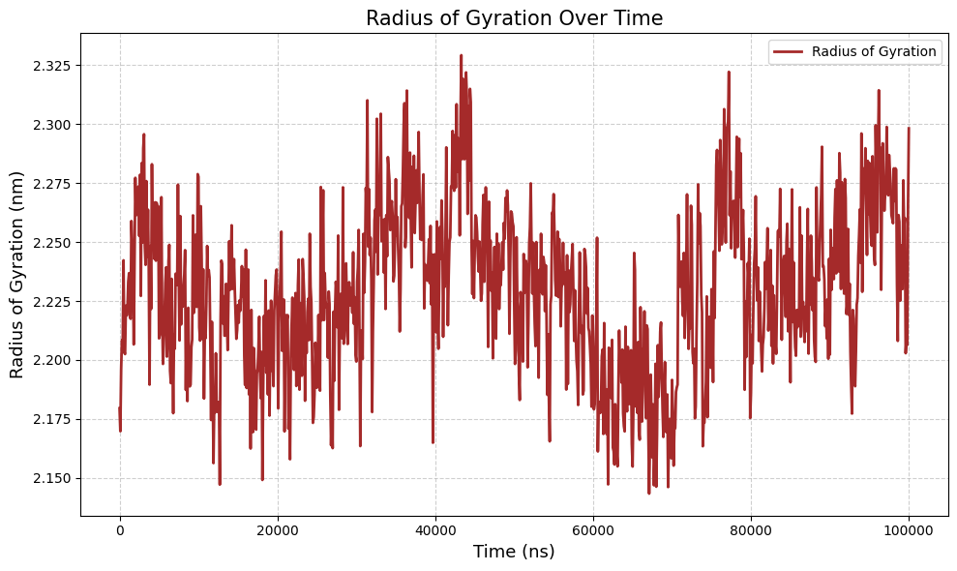
Analysis of Graph :
RMSD-Root Mean Square Deviation
What it shows: How much our protein/AMP’s structure deviates from its starting shape or position over time. Key Points:
Lower final RMSD (~0.3 nm) = more rigid/stable structure.
Conclusion: our protein/AMP is well-folded and doesn’t unravel.
What the Graph Shows:
The Radius of Gyration (Rg) measures how compact or extended your protein/AMP is during the simulation.
The Rg analysis shows our protein/AMP maintains a stable compactness (consistent Rg value), indicating a well-folded structure, not undergoing unfolding or major conformational changes, which is essential for its biological activity, especially in antimicrobial action.
Radius of Gyration

Slide 22
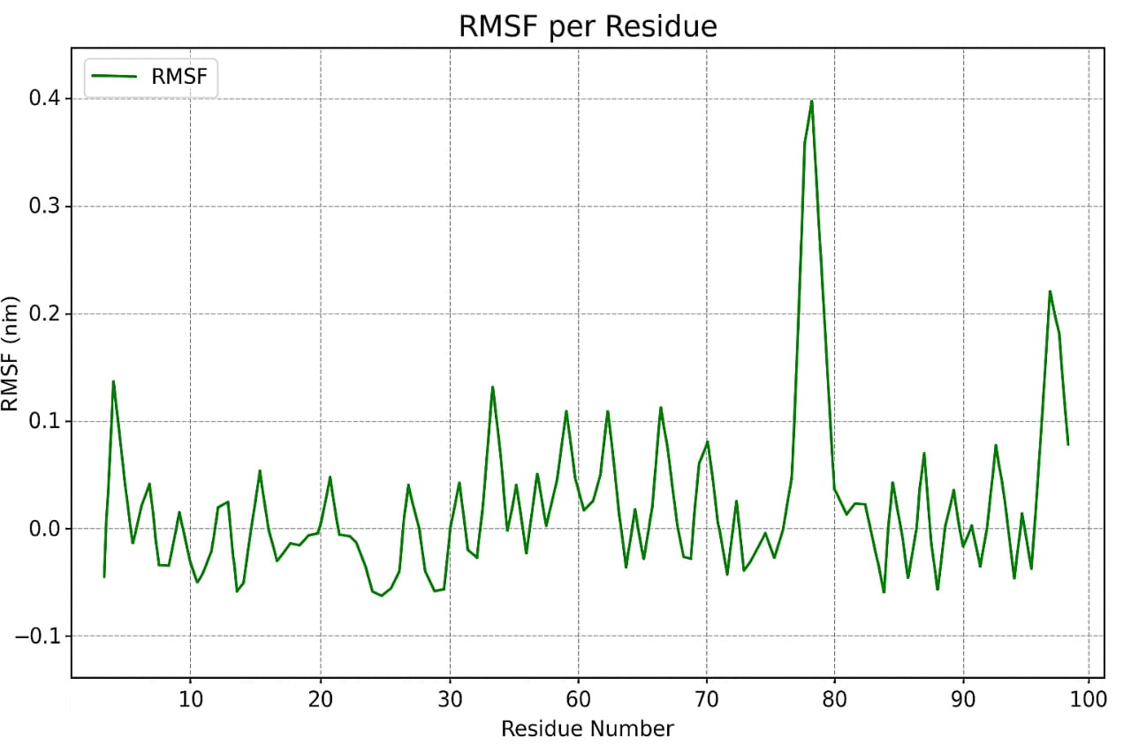
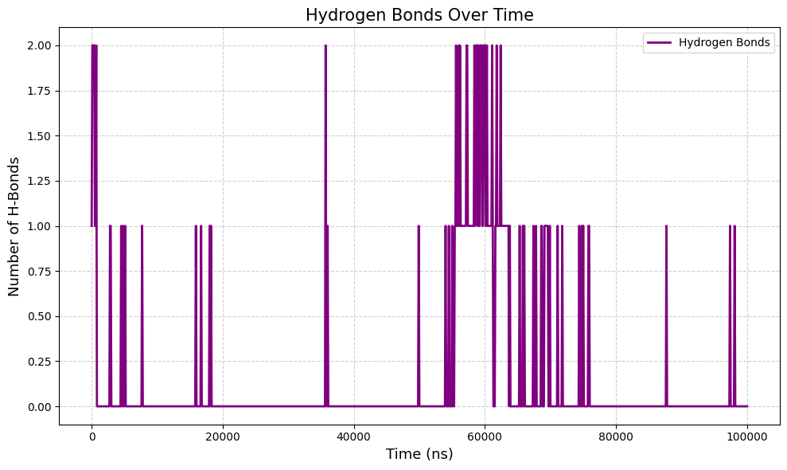
Root Mean Square Fluctuation
What it shows: Which parts of our protein/AMP are flexible (peaks) or rigid (flat areas). Key Points:
Flat regions = stable helices/sheets.
Conclusion: Flexible areas might be binding sites or functional regions.
What it shows: How many H-bonds form over time (critical for stability!). Key Points:
More H-bonds = stronger binding.
Conclusion: our protein/AMP maintains structural integrity
Hydrogen Bonds

Slide 23
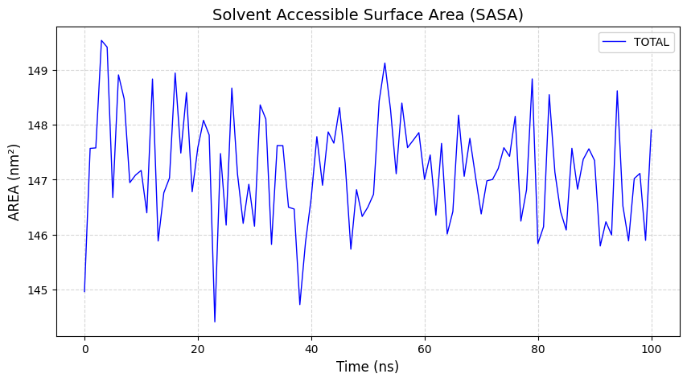
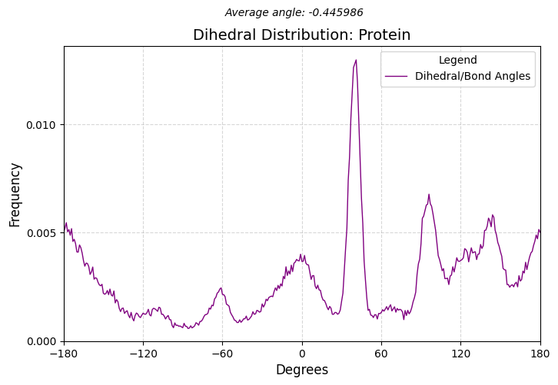
Solvent Accessible Surface Area
What it shows: How much surface is exposed to water (hides hydrophobic cores). Key Points:
Higher SASA in AMPs = more water interaction (may help disrupt bacteria).
Conclusion: Our system is properly folded (no exposed hydrophobic patches).
What it shows: Preferred rotations of bonds (like protein backbone twists). Key Points:
Sharp peaks (near -45°) = stable conformations (e.g., α-helices).
Broad peaks = flexible regions.
Conclusion: our protein/AMP has well-defined structures (no random folding).
Average Angle

Slide 24
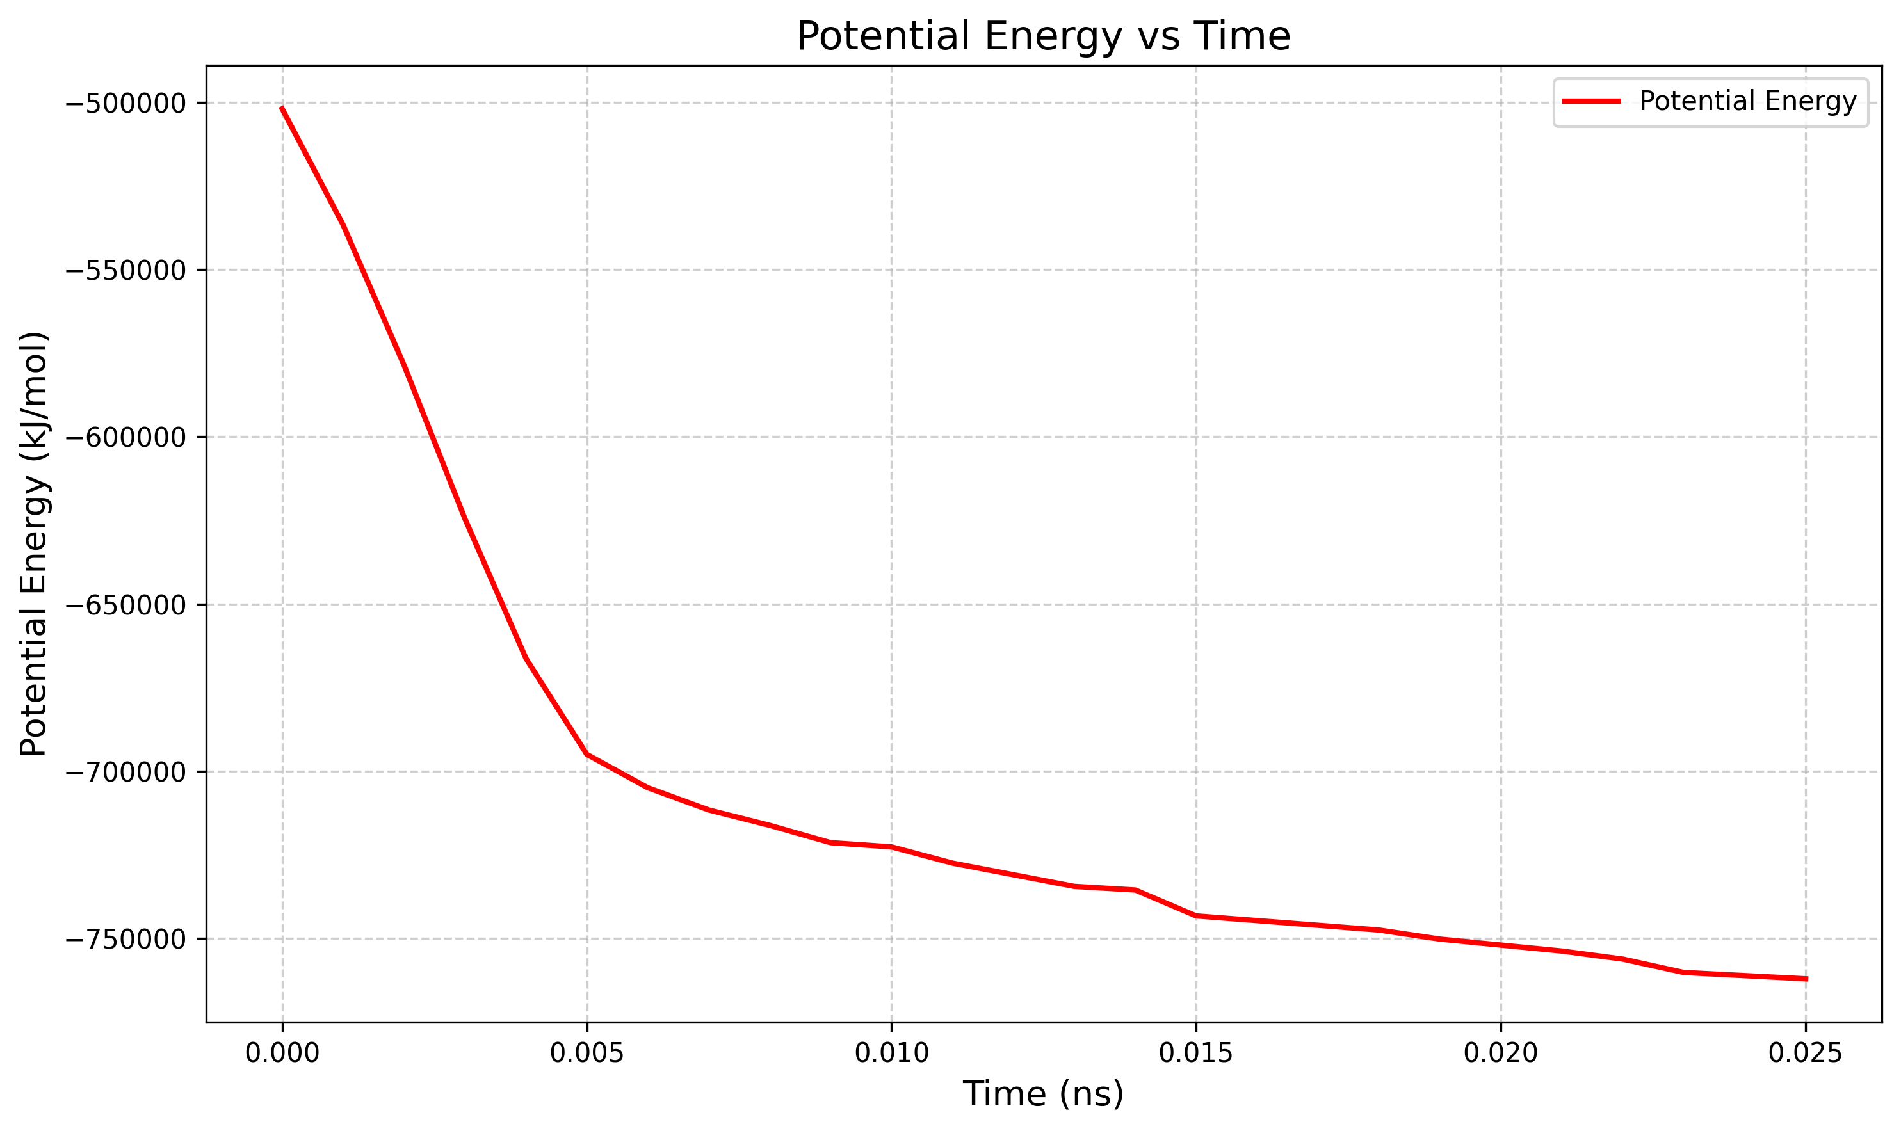
Potential Energy Graph
What it shows: Whether our simulation ran correctly (no crashes/errors). Key Points:
Energy stabilizes quickly (after 0.005ns) = good equilibration.
Conclusion: our simulation is reliable for analysis.
The molecular dynamics simulations of Peptide_7 (Scolopendin 2) in complex with the CFTR target revealed consistent stability and effective binding, as evidenced by favorable RMSD, RMSF, Rg, SASA, Potential energy and H-bond profiles. These results suggest that Peptide_7 is a promising candidate for further investigation.

Slide 25

CONCLUSION
This study identifies Scolopendin 2 as a Potential Antimicrobial Peptide for Cystic Fibrosis therapy using network pharmacology, docking, and molecular dynamics. It binds and stabilizes CFTR, showing antimicrobial and biofilm-disrupting effects. The findings offer a computational framework for AMP-based strategies targeting both infection and CFTR dysfunction in CF. My research supports SDG 3 by developing an innovative AMP-based therapy for CF, aiming to improve patient health outcomes and overall quality of life.

Slide 26
REFERENCE
Albane Jouault, Inès Jeguirim, Inès Ben Hadj Kaddour and Lhousseine Touqui. (2025). 'Assessment of the efficacy of an antimicrobial peptide in the context of cystic fibrosis airways', Current Research in Microbial Sciences, vol.8, pp.100367.
Aluísio Marques Da Fonseca, Bernardino Joaquim Caluaco, Junilson Martinho Canjanja Madureira, Sadrack Queque Cabongo, Eduardo Menezes Gaieta, Faustino Djata, Regilany Paulo Colares, Moises Maia Neto, Carla Freire Celedonio Fernandes and Gabrielle Silva Marinho. (2024). 'Screening of potential inhibitors targeting the main protease structure of SARS-CoV-2 via molecular docking, and approach with molecular dynamics, RMSD, RMSF, H-bond, SASA and MMGBSA', Molecular biotechnology, vol.66, No.8, pp.1919-1933.
Bin Yang, Hongyan Yang, Jianlong Liang, Jiarou Chen, Chunhua Wang, Yuanyuan Wang, Jincai Wang, Wenhui Luo, Tao Deng and Jialiang Guo. (2024). 'A review on the screening methods for the discovery of natural antimicrobial peptides', Journal of Pharmaceutical Analysis, pp.101046.
Damian Szklarczyk, Katerina Nastou, Mikaela Koutrouli, Rebecca Kirsch, Farrokh Mehryary, Radja Hachilif, Dewei Hu, Matteo E Peluso, Qingyao Huang and Tao Fang. (2025). 'The STRING database in 2025: protein networks with directionality of regulation', Nucleic Acids Research, vol.53, No.D1, pp.D730-D737.
Davide Buzzao, Lukas Steininger, Dimitri Guala and Erik Ll Sonnhammer. (2025). 'The FunCoup Cytoscape App: multi-species network analysis and visualization', Bioinformatics, vol.41, No.1, pp.btae739.
Doni Dermawan and Nasser Alotaiq. (2025). 'Computational analysis of antimicrobial peptides targeting key receptors in infection-related cardiovascular diseases: Molecular docking and dynamics insights', Scientific Reports, vol.15, No.1, pp.8896.

Slide 27
REFERENCE
Huabiao Miao, Lu Wang, Qian Wu and Zunxi Huang. (2025). 'Antimicrobial peptides: mechanism, expressions, and optimization strategies', Probiotics and Antimicrobial Proteins, vol.17, No.2, pp.857-872.
Mateusz Zalewski, BjöRn Wallner and Sebastian Kmiecik. (2025). 'Protein–Peptide Docking with ESMFold Language Model', Journal of Chemical Theory and Computation, vol.21, No.6, pp.2817-2821.
Muhammed T Muhammed and Esin Aki-Yalcin. (2024). 'Molecular docking: Principles, advances, and its applications in drug discovery', Letters in Drug Design & Discovery, vol.21, No.3, pp.480-495.
Vito Terlizzi and Miquéias Lopes-Pacheco. (2025). 'Cystic fibrosis: new challenges and perspectives beyond elexacaftor/tezacaftor/ivacaftor', Therapeutic Advances in Respiratory Disease, vol.19, pp.17534666251323194.
GROMACS Development Team. (2022). GROMACS Documentation: Release 2022.3. Available at: https://manual.gromacs.org/documentation/2022.3/manual.pdf [Accessed 13 Apr. 2025].
Wei Cai, Yukun Zhu and Jianzhong Xu. (2025). 'Bioinformatics analysis and identification of hub genes and their role in immune infiltration in osteoarthritis', Chinese Journal of Tissue Engineering Research, vol.29, No.18, pp.3747.
Zhaolin Huang, Dawei Ni, Ziwei Chen, Yingying Zhu, Wenli Zhang and Wanmeng Mu. (2024). 'Application of molecular dynamics simulation in the field of food enzymes: Improving the thermal-stability and catalytic ability', Critical Reviews in Food Science and Nutrition, vol.64, No.31, pp.11396-11408.

Slide 28
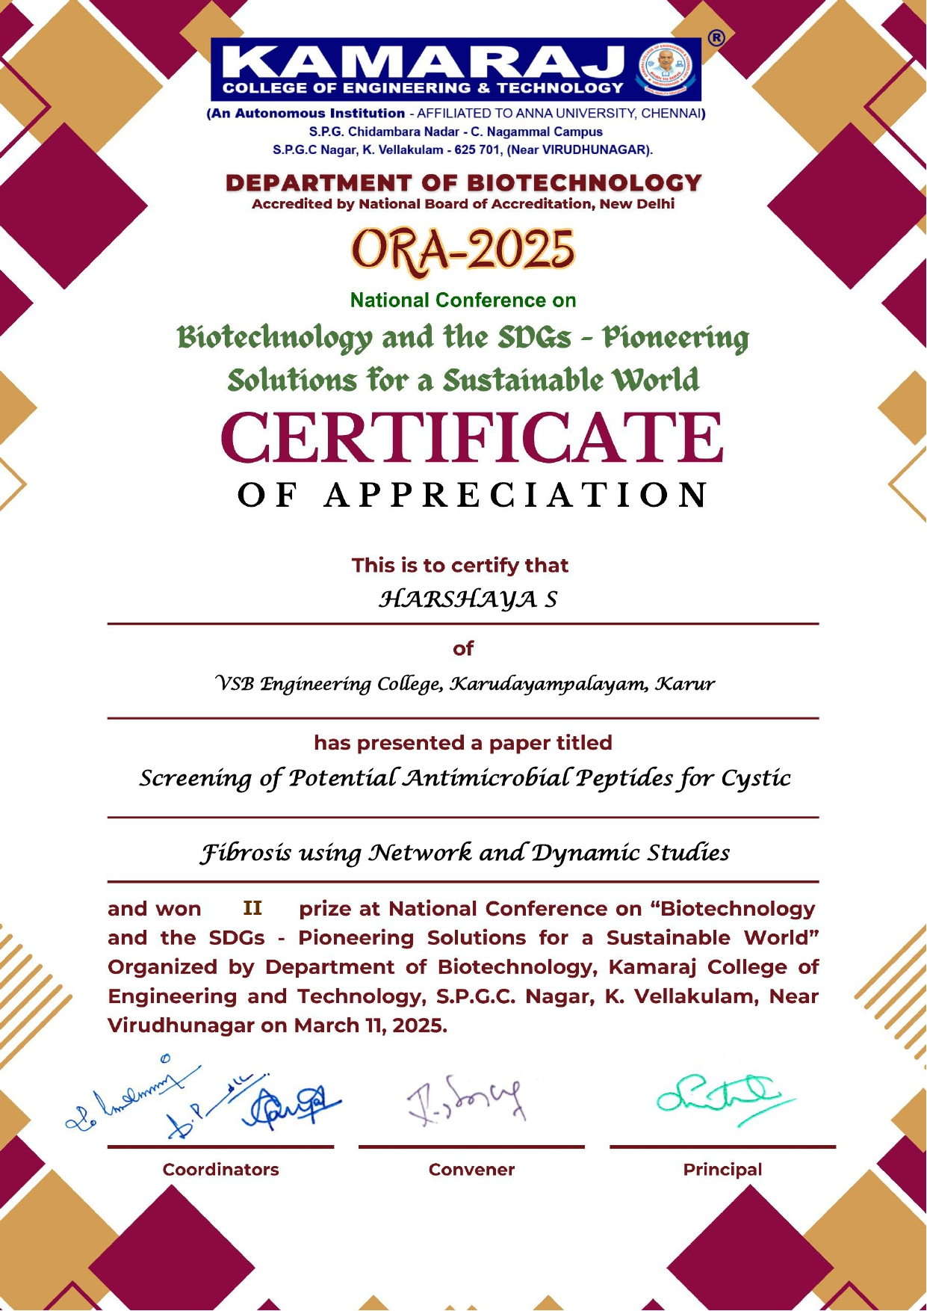

CONFERENCE PRESENTED

Slide 29


